Slide 1
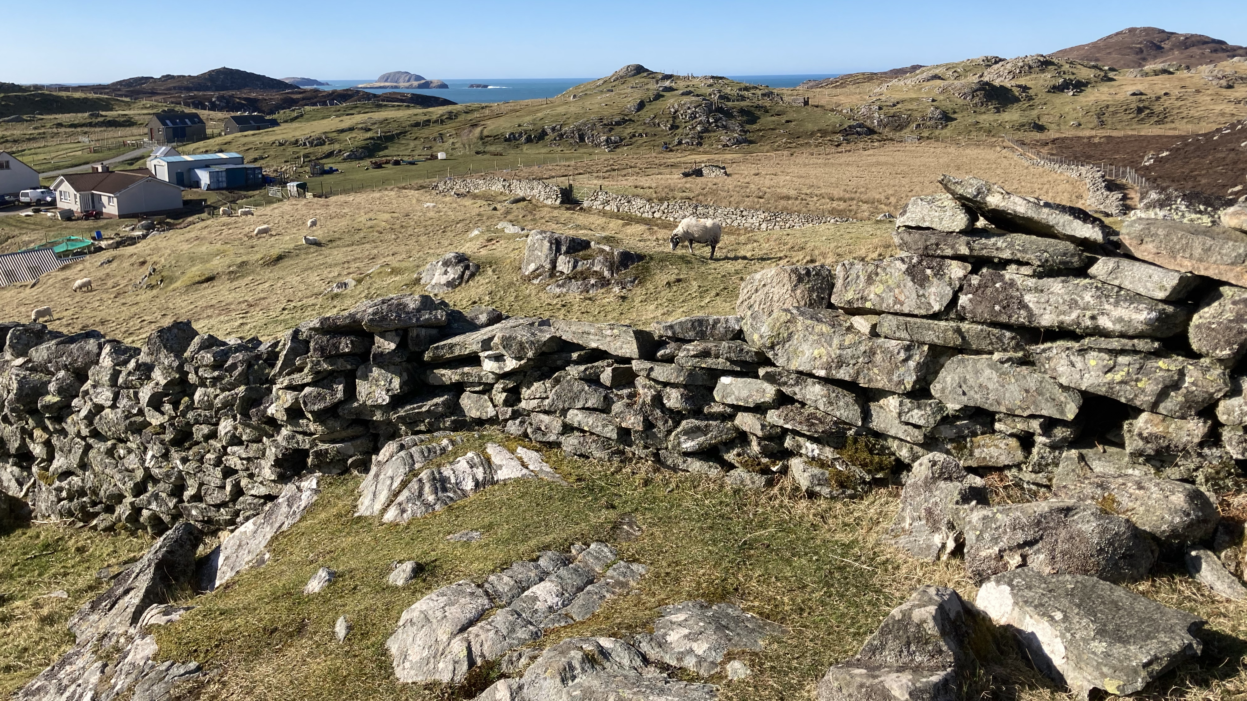
Predication and the content of roots
Sylvia L.R. Schreiner
George Mason University
Externalizing words: Mono- and Multilingual Perspectives
Penn State University, March 23-25, 2023

Slide 2
Acknowledgments
Many thanks to Muriel Fisher, Margaret Stewart, Murdo MacDonald, Anne Frater, Katie MacKinsey, Iain MacAulay, and Angela MacKinnon
Work originating in dissertation, Schreiner 2015, Schreiner 2019: Thanks to Andrew Carnie, Heidi Harley, Bridget Copley (CNRS/Université Paris 8), Roumyana Pancheva, Hamida Demirdache, Isabelle Roy, an anonymous LSA reviewer, three anonymous Lingua reviewers, and the audience and reviewers at NELS 2018
Research funded in part by a GMU Mathy Junior Faculty Awards in the Arts and Humanities. Research also undertaken at the University of Arizona funded in part by the National Science Foundation (#BCS0602768A), and in part by a pre-doctoral grant from the University of Arizona Social and Behavioral Sciences Research Institute; at Wheaton College, MA; and at University of Illinois at Urbana-Champaign.

Slide 3
Roadmap
Scottish Gaelic, variation, and methods
Nominal predication in Gaelic: ‘dense’ predicates need structure
Analysis
Bonus: “span” nominals in Gaelic
Connections and implications
Outstanding questions

Slide 4
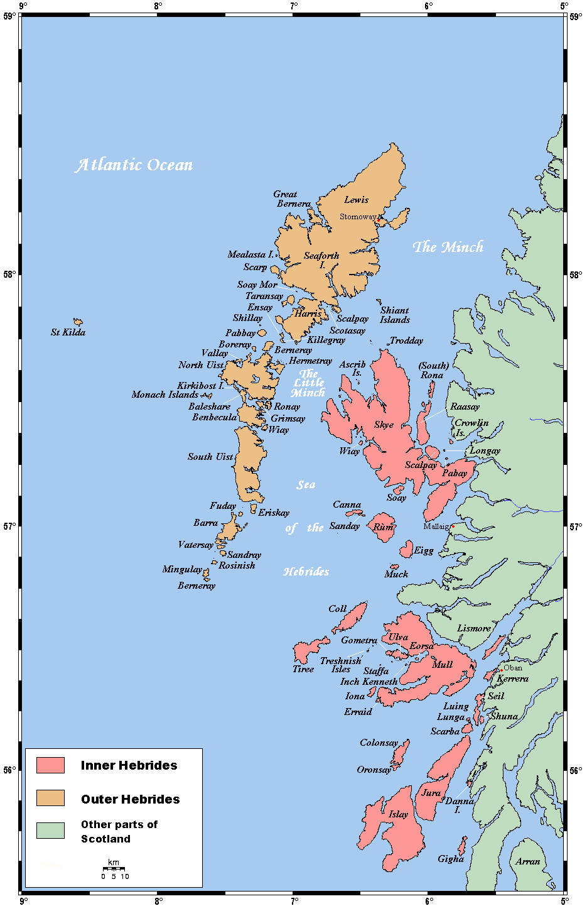
Scottish gaelic
Significant revitalization efforts in the past decades; current EGIDS level 2
Gaelic-medium education available
Generational differences persist
Spoken in the highlands and islands; most prevalent in L1 speakers in the islands
Source: Wikipedia (user Kelisi), shared under Creative Commons Attribution-Share Alike 3.0 Unported

Slide 5
Variation
Seven speakers: mid 50s-early 70s
Skye (Glendale), eastern Lewis (Col), western Lewis (Shader), eastern Lewis (an Rubha), Harris, North Uist (all Gaelic til school); Glasgow & Eriskay (English first, Gaelic before school age)
Variation example: <dèidh>

Slide 6
Variation
Skye: as dèidh﻿ roughly [as dʒoi ~dʒɯi ~dʒɤi]
Lewis: ﻿an dèidh and an dèidh 's, roughly [an jej] and [an jejs]
Harris: an dèidh and an dèidh 's, roughly ﻿[an djo.i^{j}] and [an djo.i^{j}s]
Eriskay: an dèidh and an dèidh ‘s, roughly [an dʒej] and [an dʒejs]

Slide 7
Methods
First data set: Elicitations w/speaker from Skye; most data checked/replicated by
Second data set: Elicitations with speakers from Skye, Lewis (x2), Harris, North Uist, and Eriskay (alongside gathering data on variation in perfect aspects)
Initial email/phone 2016; in-person August 2018 at Sabhal Mòr Ostaig, Skye; in-person in March 2022 in Stornoway, Lewis
English used as metalanguage
Translation from English, grammaticality/felicity judgements

Slide 8
Predication in Gaelic
Verbal, adjectival, prepositional predication
(1) Dh’ith Iain am marag
eat.PST Iain the pudding
‘Iain ate the pudding’
(2) Tha Iain ag ithe am marag
be.PRS Iain PROG eat.VN the pudding
‘Iain was eating the pudding’

Slide 9
Predication in Gaelic
Verbal, adjectival, prepositional predication (≈ stage-level)
(3) Tha Màiri sgìth
be.PRS Mairi tired
‘Mairi is tired’
(4) Tha Màiri aig an tràigh
be.PRS Mairi at the beach
‘Mairi is at the beach’

Slide 10
Predication in Gaelic
Nominal predication
(5) %Is fear Calum
COP.PRS man Calum
‘Calum is a man’
(6) Tha Calum ’na dhotair
be.PRS Calum in.GEN.3SM doctor
‘Calum is/works as a doctor’
(≈ Individual-level vs. stage level; Schreiner (2015): Roy (2006/2013) maximal vs. dense predicates)

Slide 11
Predication in Gaelic
Predication and equation in Gaelic
(5b) ’S e fear a th’ ann a Calum
COP.PRS it man COMP be.PRS in Calum
‘Calum is a man’
(5c) ’S e Calum an tidsear
COP.PRS AUG Calum the teacher
‘Calum is the teacher’
(Adger & Ramchand 2003:339)

Slide 12
Predication in Gaelic
Verbal predication with ≈ sit/stand/lie verbs (‘sit’, ‘stand’, ‘lie’, ‘stretch out’, ‘rest’, ‘stop’, ‘sleep’, ‘wake’, and ‘run’)
(7) Tha e a’ suidhe
be.PRES he PROG sit.VN
‘He is sitting down [process]’
(8) Tha e ’na shuidhe
be.PRES he in.GEN.1s sit.VN
‘He is sitting down/seated [state]’

Slide 13
Schreiner (2015) analysis
Takeaway: We can unite these types of predication; in both cases, the construction with ‘in.GEN.AGR’ is forming predicates with “dense” interpretations
Roy’s (2006/2013) ‘density’ (product of the functional structure) + homogeneity (a property of roots) (after after Bennett and Partee, 1972; Taylor, 1977; Dowty, 1979, and others)

Slide 14
Schreiner (2015) analysis
When do we get a ‘‘dense’’ nominal predicate in SG?
Dense reading of a typical nominal; or
If a root tagged as homogeneous and pertaining to posture requires a dense predicate in order to be interpretable.
There is no nominal functional material that can create dense predicates in SG, so the nominal is embedded in a prepositional structure headed by in.GEN.AGR.

Slide 15
Schreiner (2015) analysis
Sentences with is define (“who”, <Higgins 1979); sentences with tha + ‘in’ describe (“what”)
Lachy is an Englishman: is
Lachy is [being] an Englishman: tha + ‘in’
Ugh, Lachy’s an Englishman: tha + ‘in’

Slide 16
Schreiner (2015) analysis
Sentences with is define (“who”); sentences with tha + ‘in’ describe (“what”)
What does Maighread do? She is a doctor (in Glasgow): tha + ‘in’
Don’t worry about that person looking in your son’s mouth, she’s a doctor: is
Who is Maighread? She’s a doctor: is
She’s not a child at all—she’s a woman now: tha + ‘in’

Slide 17
Schreiner (2015) analysis
Doesn’t rule out a two-way distinction (Carlson 1977, Diesing 1988, Kratzer 1995, Kratzer 1998 etc.), but – tha + ‘in’ is not just for spatiotemporal slices – also for things that are generally true but not defining of an individual

Slide 18
Schreiner (2015) analysis
Sit/stand/lie verbs (+ run!) (Dowty 1979, etc.)
How is she getting here? She’s running (i.e., process) :
✓a’, #na (yields ‘she’s on a run’)
The river runs through town :
✓a’ (habitual), #na (yields ‘a river is running through town’)

Slide 19
Roy’s account
Roy (2006/2013): three-way distinction in non-verbal predication
Maximal predicates (e.g., French nouns with the indefinite article) define an individual (NumP, MAX operator)
Dense predicates describe a situation; homogeneous like mass nouns (other structure, e.g. PP)
Non-dense predicates yield characterizing sentences; equivalent of atomic/count nouns (ClassP)

Slide 20
Schreiner (2015) analysis
Nominal situation: tha + ‘in’ yields situation-descriptive sentences; these involve dense predicates in which no gaps obtain (generic/habitual readings arise from an independently motivated generic operator (e.g. Carlson 1989), as argued for by Ramchand 1996, Roy)

Slide 21
Schreiner (2015) analysis
Why do we need the preposition to form this kind of nominal predicate?
Ramchand (1996) and Adger & Ramchand (2003): nominals in Gaelic are always referential; is selects for these while tha selects for predicates—so must embed the nominal in P material (which carries an eventuality variable)
Roy—wider set of claims

Slide 22
Schreiner (2015) analysis
Roy: All lexical categories can be predicates; all predicates have eventuality arguments—but lexical categories must be in some functional material
Dense/non-dense distinction parallel to mass/count, but this arises from the functional structure

Slide 23
Schreiner (2015) analysis
NumP: “maximal” predicates, defining readings
ClP: atomic/count structures, including non-dense predicates—count readings
Otherwise, mass interpretation is the default, including dense interpretations of a predicate

Slide 24
Schreiner (2015) analysis
Cross-linguistically, Roy’s analysis says that if we want a dense reading of a a nonverbal predicate, we can have a PP, or (for a nominal) a nominal embedded in other structure
ClP will yield non-dense, NumP + Max operator will yield maximal predicates.
Roy: Irish, Schreiner: Gaelic—embed in PP for dense predicate

Slide 25
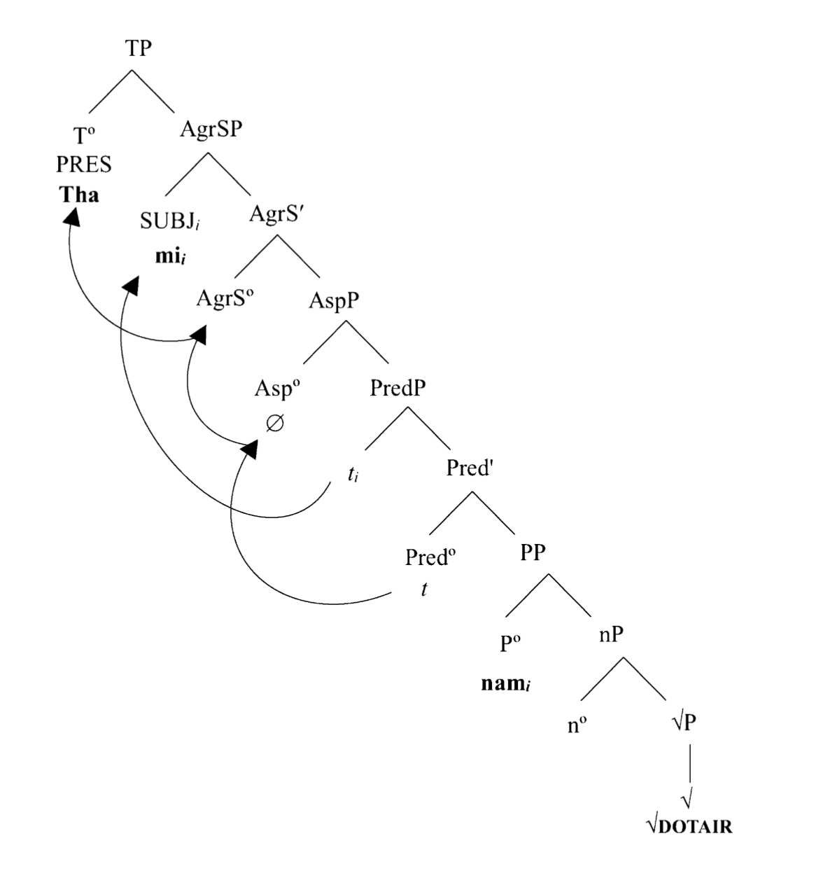
Schreiner (2015) analysis
AspP is projected in all sentences other than those with is; here Asp is null but still binds the eventuality argument etc.
[[Ø]] = λP.λt.∃e: [t = t(e) & P(e)]
(Harley 2014-style √P)

Slide 26
Schreiner (2015) analysis
Ok, so what about the sit/stand/lie verbs?
These “verbal nouns” are nominal, subject to the same predication strategy as their more obviously nominal counterparts
The roots that participate in the construction do so because they are tagged for having a particular kind of meaning in nonverbal environments—importantly, a kind of meaning that is uninterpretable in anything but a dense predicate.

Slide 27
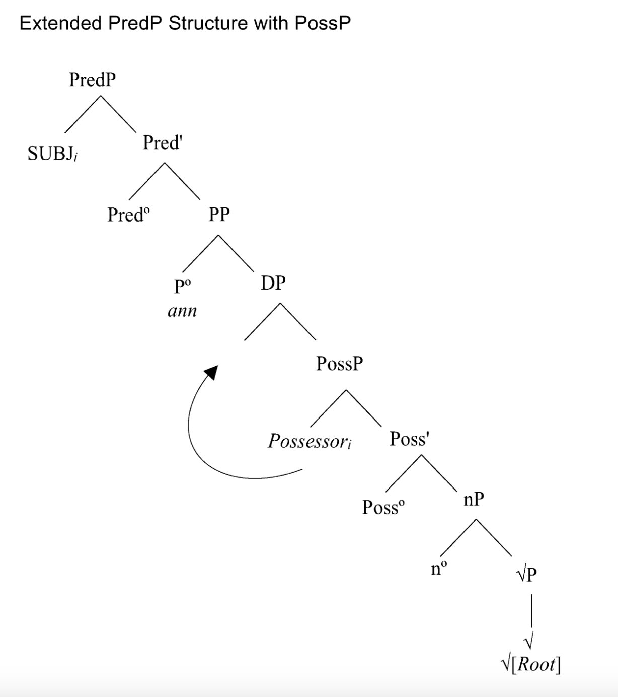
Schreiner (2015) analysis
First of all, what’s with the subject-agreeing genitive inflection on the preposition?
Maybe akin to the possession in ‘in her childhood’
Part of a possessive structure—inside PossP, merged with nP before the rest of the structure (pronoun starts in Spec,PossP and raises to Spec,DP to check genitive

Slide 28
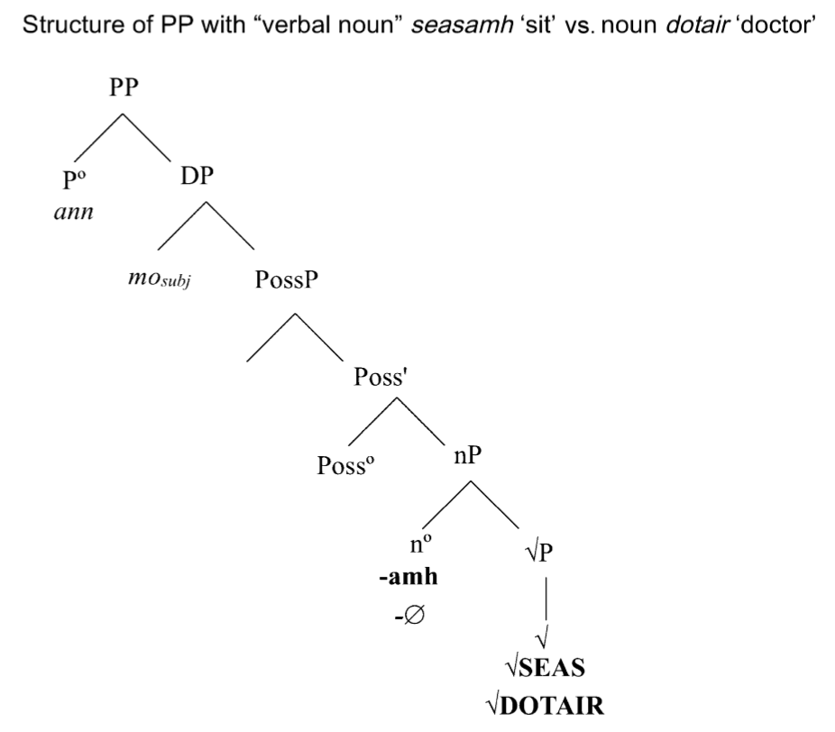
Schreiner (2015) analysis
A special nominalizer (instantiation of n) (explains why we don’t see the pronoun in adjectival or verbal preds)
Perhaps dense nominal preds result from an nP headed by this particular kind of n—required merge with Poss
(Default nominalizer only merges with Poss when dictated by semantics)

Slide 29
Schreiner (2015) analysis
So why this set of roots? We need:
(1) The semantics of the roots and their resulting possible interpretations
(2) Interpretation instructions that can link different interpretations to different morphosyntactic environments
(3) An interpretability claim about homogeneity and density in these particular predicates

Slide 30
Schreiner (2015) analysis
“verb-y” roots indexed (e.g. Pfau 2000, 2009; Acquaviva 2008; Harley 2014); ‘tagged’ with features for body/mind, posture; homogeneous in non-verbal environments
√135 ↔ [+body] & [+posture] &
posture(‘‘sit’’) &
HOM(‘‘sit’’) / [n/adj[__]√]
(In a verbal environment, can get either homogeneous (‘sat for 5 hours’) or non (‘sat down quickly’) interpretations)

Slide 31
Schreiner (2015) analysis
“noun-y” roots
√277 ↔ [+human] & [+occupation] &
occupation(‘‘doctor’’) &
HET(‘‘doctor’’) / [v[__]√]
So e.g. ‘plumber-ing’ means ‘doing plumber-ing things’, not ‘having plumber as a profession’ No instructions about homogeneity outside of verbal environment—could get either interpretation

Slide 32
Schreiner (2015) analysis
So for sit/stand/lie “verbs”—
The roots are tagged as homogenous and postural; the only nominal functional material that will yield an interpretable structure for these is the structure that yields dense predicates
A non-dense reading of a homogeneous posture interrupts that posture
So such a root as a nominal is only interpretable in nP in a PP

Slide 33
Non-dense predication?
Ok Sylvia, but is there any evidence of non-dense (“count”) predication?

Slide 34
Span predicates
(9) Tha e/*i bliadhna *(bhon a bha thu an seo)
be.PRS he/she year(F) from COMP be.PST you here
‘It is [/has been] a year since you were here’ (S2, Skye)

Slide 35
Span predicates
The structure in question:
tha + (e) + [distance/time] + [from/since x (to y)]
 | Skye | Lewis/(Harris/Eriskay) |  | North Uist
time since | tha e | tha |  | tha
time between | tha e | tha e* | tha
distance since | tha e | tha (e) |  | tha
distance between | tha e | tha (e) |  | tha
* Shader speaker

Slide 36
Span predicates
Sentences with tha + [time] + [since x] look like kind of like prepositional predicates, but...
(10) Tha mìle [bhon a seo gu Steòrnabhagh]_{PP}
be.PRS mile from here to Stornoway
‘It’s a mile from here to Stornoway’
#?‘A mile is from here to Stornoway’
(We’ll come back to this)

Slide 37
Span predicates
First: tha e, then we’ll come back to the thas
(7) Tha e/*i bliadhna *(bhon a bha thu an seo)
be.PRS he/she year(F) from COMP be.PST you here
‘It is [/has been] a year since you were here’ (S2 Skye)
Questions: what is the pronoun?
Could be an expletive (e.g. expletive pronouns in clefts, Adger 2011; though cf. McCloskey 1996)

Slide 38
Span predicates
I argue:
The pronoun is not pleonastic; it refers to the span described by the nominal;
The nominal merges with a null classifier that is semantically compatible with roots that have an interpretation in the context of [SPAN];
These sentences involve a type of nominal predicate not otherwise found in the language (corresponding to Roy’s “non-dense” or “characterizing” predicates)

Slide 39
More data
(11) Tha e/*i bliadhna *(bhon a bha thu an seo)
be.PRS 3SM/3SF year(F) from COMP be.PST you here
‘It is [/has been] a year since you were here’ (S2, Skye)
(12) Tha e/*i mìos/latha/dà bhliadhna *(bhon a bha thu an seo)
be.PRS e month/day/two year from C be.PST you here
‘It is a month/day/two years since you were here’ (S2, Skye)
(13) Tha e/*i seachdainn bhon a thachair e
be.PRS 3SGM/3SGF week(F) from C happen.PST 3SGM
‘It is a week since it happened’ (S2, Skye)

Slide 40
More data
(14) Tha e dà mhìle *(bho seo gus an aiseag)
be.PRS e two mile from here to the ferry
‘It is two miles from here to the ferry’ (S2, Skye)
(15) Tha e deich mìle air fhichead bhon a thachair sin
be.PRS e ten mile on twenty from C happen.PST that
‘It is thirty miles since that happened’ (S2, Skye)
(16) Tha e coig mionaidean bhon a sheo gus a rubha
be.PRS e five minute.P from here to the point/headland
‘It is five minutes from here to the point’ (S2, Skye)

Slide 41
More data
No definite nominals:
(17) *Tha e a’ bhliadhna (air fada) bhon a thachair e
be.PST e the year on long from C see.PST it
Intended: ‘It’s the (whole) year since it happened’ (S2, Skye)
Not as a kind of cleft:
(18) *Tha e fichead rionnagan a bha mi air a cunntadh a-nis
be.PRS e twenty star.P C be.PST I PRF count.VN now
‘It is twenty stars that I have counted now’ (S2, Skye)

Slide 42
More data
No mass nouns (even when conceived of as a span):
(19) *Bha e brochan bhon a sheo dhan a rubha!
be.PST e porridge from here to the point
Intended: ‘It’s porridge from here to the point!’ (S2, Skye)
Unconventional measures ok if you set them up:
(20) %Tha e fichead peann bhon a sheo gus a rubha
be.PRS e twenty pen from here to the point
‘It is twenty pens from here until the point’ (S2, Skye)

Slide 43
Non-dense predicates?
Roy’s account predicts possible grammaticality for a structure like (21):
(21) *[Tha e [ClP[nP dotair.]]]
be.PRS he ∅ doctor
Intended: ‘He is a doctor [off and on].’
Proposal: there is a null classifier head in Gaelic, but it merges only with nominals interpretable as spans
The pronoun refers to the span itself

Slide 44
Non-dense predicates?
Root with a span interpretation merges with a light noun—a [SPAN] nominalizer (à la Kramer & Winchester 2018 on plurality in herd nouns), e.g. bliadhna ‘year’
√418 ↔ [+time] & […] & time(“year”) & span(“year”) / [n[+span][__]√]
Resulting nP can’t form a predicate (same issue we’ve been having with our bare nominals)
This time, to form a non-dense (count) predicate, nP merges with a null [+span] classifier
The projected ClP merges with Pred, etc. to form a “characterizing” (rather than “situation-descriptive”

Slide 45
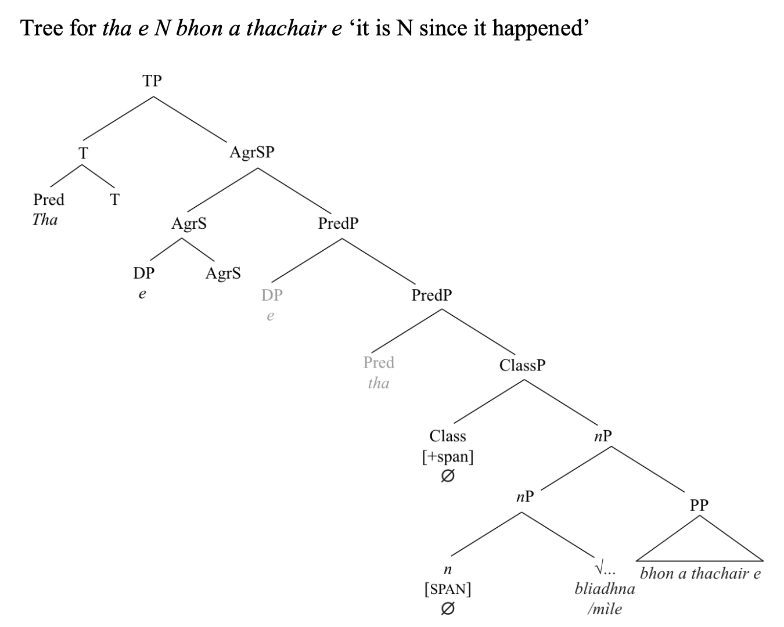

Slide 46
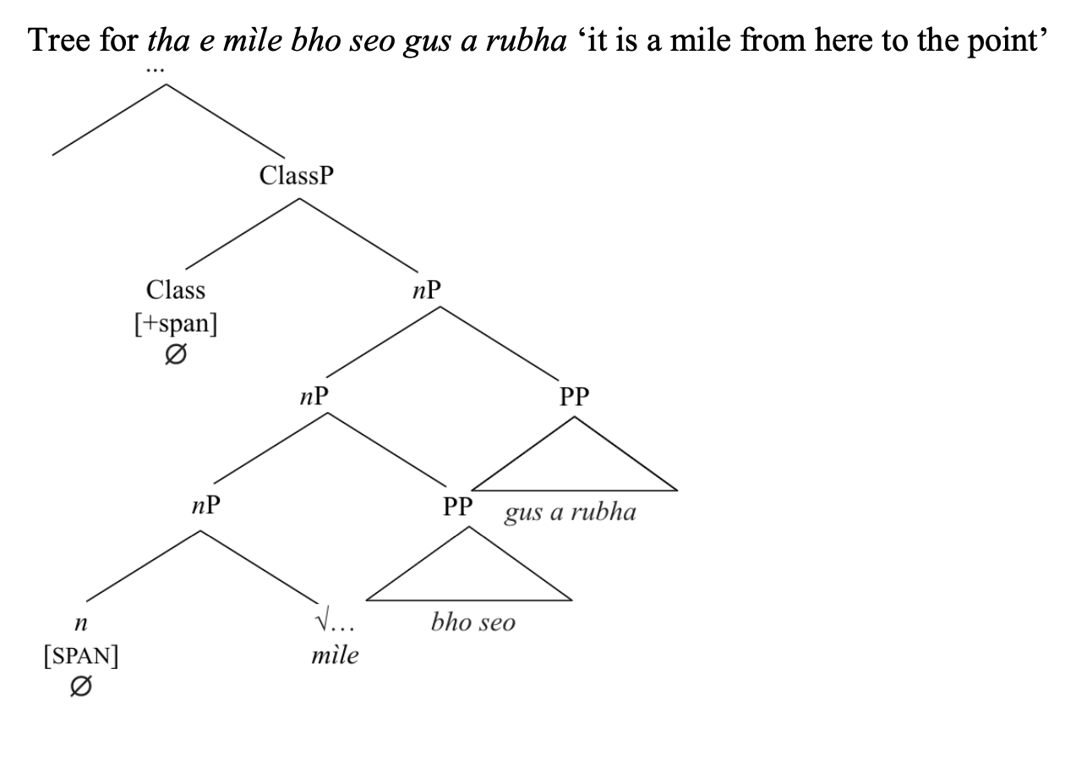

Slide 47
Variation
What about the other varieties?

Slide 48
 | Skye | Lewis |  | North Uist
time since | tha e | tha |  | tha
time between | tha e | tha e* | tha
distance since | tha e | tha (e)** |  | tha
distance between | tha e | tha (e)** |  | tha
* Shader speaker; **Col speaker
North Uist speaker: pro-drop? ☺ Or maybe interpreted as prepositional predicates?
Lewis speakers:
Distance: “could be said with or without, depending on context” (But An Rubha speaker: 20 pens, 100 degrees—no e )
Possibly an alternation between non-dense nominal predication and dense prepositional predication?
(It’s a mile between here and there vs. a mile is between here and there)

Slide 49
Issues, Connections and implications
Support (?) for Roy
Roots acategorial; still carry significant semantic content
Interpretation of the predicate depends on regularities in the (nominal) functional structure + content of the root
NumP and ClP are able to project separately (as in e.g. Roy and Gebhardt 2009, contra Picallo 2006, Alexiadiou et al. 2010) (??)

Slide 50
Outstanding questions
Are these really non-dense predicates—“states that can hold without requiring ‘evidence’ of [the predicate] to be true of all sub-parts of the event” (Roy 2006:174)?
What about when numerals are involved?
What is going on with the Lewis speakers?
Acquaviva (2006)—transnumerality in Gaelic and Irish—singular nouns as numberless...

Slide 51
Outstanding questions
Tha an rubha coig mionaidean à seo – ‘The point is 5 minutes from here’ (S4, S5 89)
Tha e ag uisge – ‘it’s raining’
Bha e air a bhith bliadhna bhon – ‘it had been a year since’ (S2, 25)

Slide 52
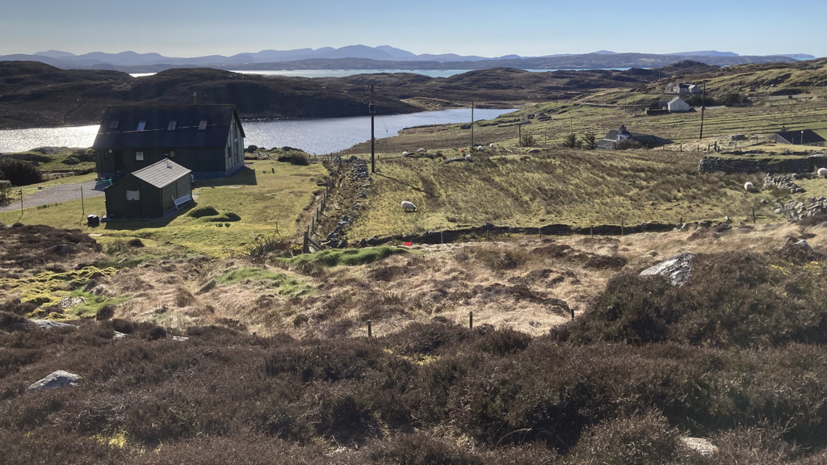
Tapadh leibh!
Igamsiqayugvikamsi!

